Slide 1
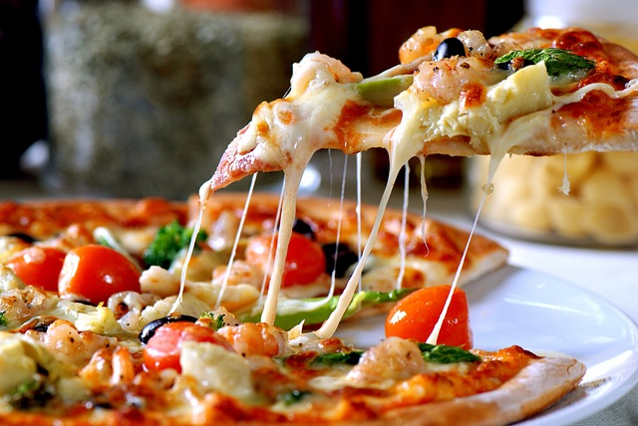
Pizza Sales Analysis
By
Shubham Bahadure

Slide 2
After analysing the Data we can calculate the customers, we have average per day Customers in every Month
Maximum numbers of per day customers in every Month. Nov month has maximum customers as compare to other Month

Slide 3
Peak days in every week and Friday was best day.
Friday our sales are increases i.e pizzas are sold up to 16.67%
Every day we have some peak Hours and that peak Hours are 12PM-1PM & 4PM-7PM

Slide 4
Using the Line Chart we will calculate the Customers per Month In July month we have maximum customers i.e 4301 customers. In Oct month we have minimum numbers of customers i.e 3797 customers.
As per the Time slot there are 58% Orders (28061) in Afternoon, 36% Orders (17750) in Evening and 6% Orders (2809) in Morning.

Slide 5
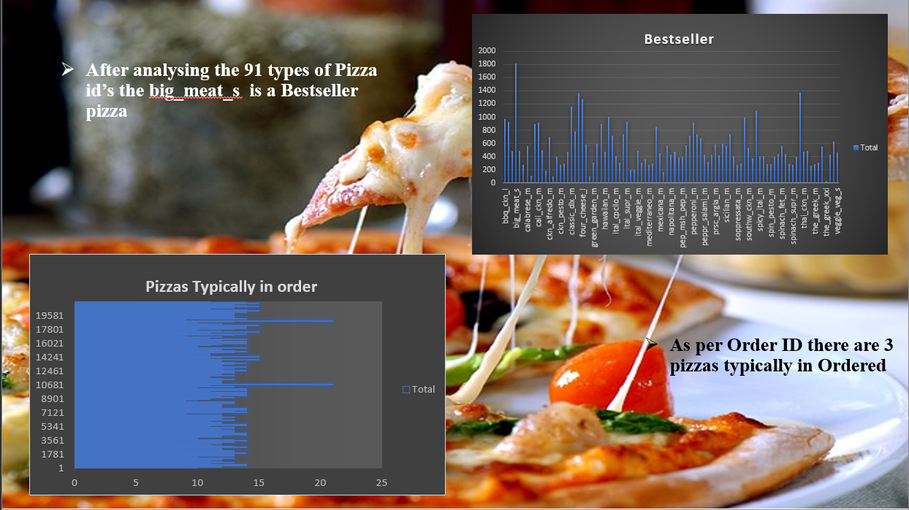

Slide 6
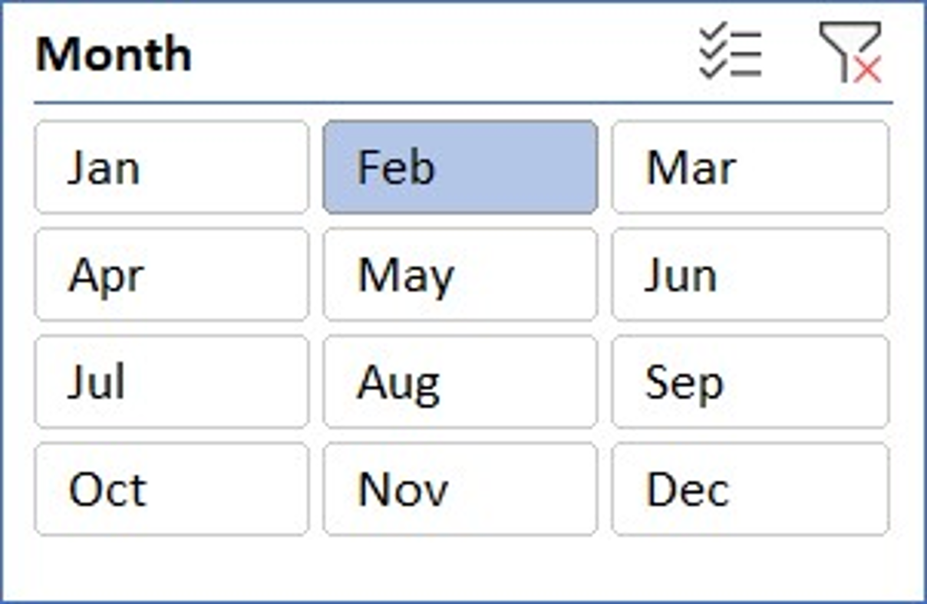
The Column chart shown the Date & Month wise Orders
Using this slicer we can change the Month and is will shows the Data of that particular Month

Slide 7
This are the Top 10 bestselled pizzas as per size (L, M, S) and prise wise . THAI_CKN L (large) size pizza, CLASSIC_DLX M(Medium) size pizza HAWAIIAN S (small) size pizza
This are Top 10 Lowselled pizzas Brie_carre is the topmost lowselled pizza

Slide 8
Seasonally selled pizzas In Winter, pepperoni 805,hawaiian 801,cali_ckn 800 Total 2406 pizza sold, summer bbq_ckn 845, classic_dlx 822, hawaiian 804 Total 2471 pizza sold, Rainy classic_dlx 821, pepperoni 816, thai_ckn 777, Total 2414 pizzas are sold

Slide 9
After selling pizzas and counting the money per month the Total money made this year is 817860.05 Rs.

Slide 10
Thank You

